Slide 1
Woodland Public Schools Transportation Model Work Shop
KWRL Transportation Cooperative
March 12, 2018

Slide 2
Woodland Public Schools
Current Hybrid Model Discussion

Slide 3
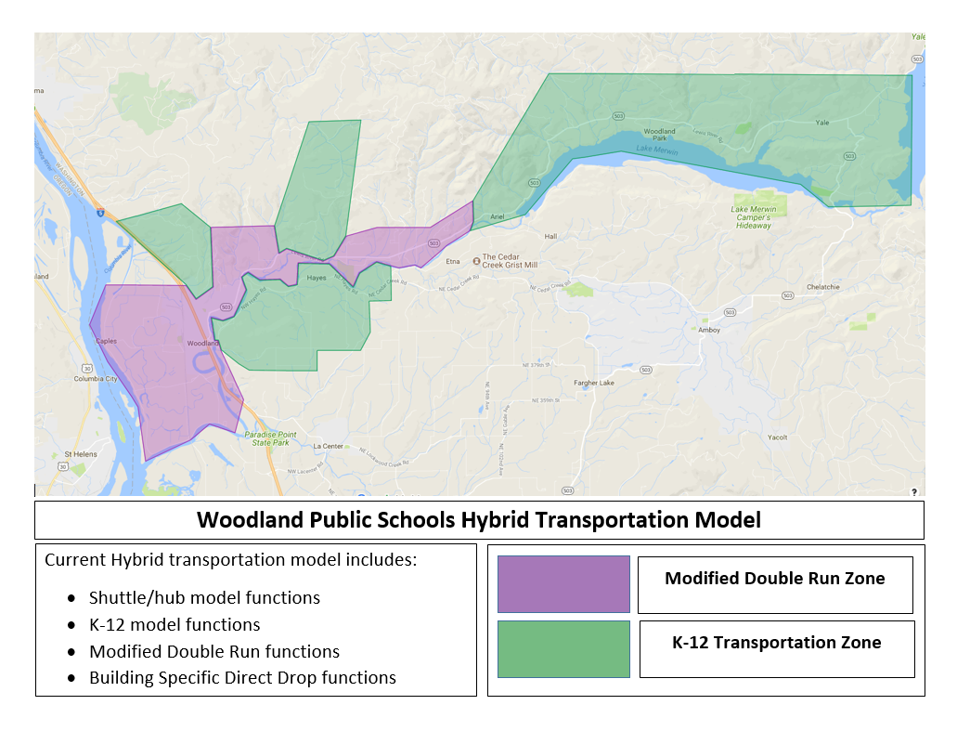

Slide 4
“Ride Time” Time spent on the school bus
 |  |  |  |  |  |  |  |  |  | WHS | WMS | WIS | WPS
Average Long |  |  |  |  |  |  |  |  |  | 57 | 60 | 60 | 67
Average Short |  |  |  |  |  |  |  |  |  | 14 | 23 | 10 | 27
Average Collective |  |  |  |  |  |  |  |  |  | 34 | 41 | 35 | 47
Extreme Long |  |  |  |  |  |  |  |  |  | 105 | 115 | 95*/74 | 120*/90
Extreme Short |  |  |  |  |  |  |  |  |  | 4 | 2 | 4 | 7
Average Time With Active Route |  |  |  |  |  |  |  |  |  | 46
Average Time From Route to Last Buidling |  |  |  |  |  |  |  |  |  | 33
All of a students time on the bus from the time they step onto the bus and up to the time they stop off the bus at their building can be broken down into one of two categories. One category would be active route “time spent gathering students bus stop to bus stop. The other category would be the time spent traveling from the last bus stop to the schools, which may be multiple schools before the student steps off the bus.

Slide 5
 |  |  |  |  |  |  |  |  |  | WHS | WMS | WIS | WPS
Average Long |  |  |  |  |  |  |  |  |  | 57 | 60 | 60 | 67
Average Short |  |  |  |  |  |  |  |  |  | 14 | 23 | 10 | 27
Average Collective |  |  |  |  |  |  |  |  |  | 34 | 41 | 35 | 47
Extreme Long |  |  |  |  |  |  |  |  |  | 105 | 115 | 95*/74 | 120*/90
Extreme Short |  |  |  |  |  |  |  |  |  | 4 | 2 | 4 | 7
Average Time With Active Route |  |  |  |  |  |  |  |  |  | 46
Average Time From Route to Last Buidling |  |  |  |  |  |  |  |  |  | 33
Longest bus rides in district are WIS or WPS students who choose to come to Woodland instead of going to Yale.
“SHORT RIDE”
The shortest bus rides are a product of two variables
Those that live in close proximity to the school
The development of building specific “direct drop” opportunities within the Hybrid model
RELATIONSHIP OF VARIABLES TO TRANSPORTATION MODELS
Hybrid model takes advantage of “direct drop” opportunities whenever possible
Hybrid developed “direct drop” opportunities to avoid the parade of buses to four buildings which would have made the wasted travel number much higher.
Double Run Model with Tiered School Model eliminates “direct drop” opportunities
Double Run Model with Neighborhood School Model nearly eliminates wasted travel

Slide 6
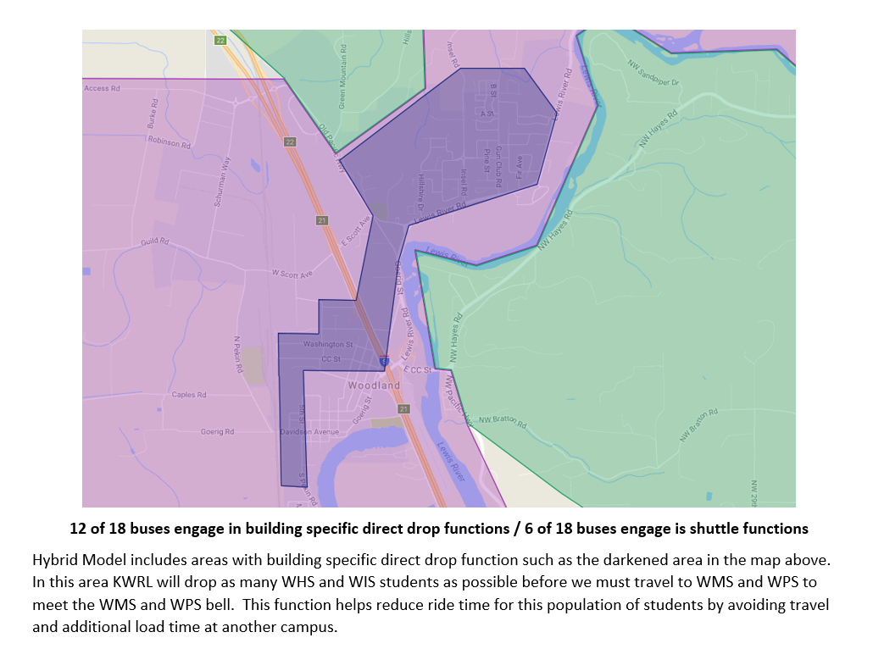

Slide 7
Two Transportation Model Options
Hybrid
Model includes variations of various models such as K-12, Modified Double Runs and Hub/Shuttles based on building and geographic location.
Double Run
Double Run – Same bus completing same route (twice)
Double Run with Tiered Buildings Bell Schedule
Double Run with Neighborhood School Bell Schedule

Slide 8
Double Run Transportation Model

Slide 9
Four Different Transportation Related Issues to Consider
K-12
Least Ride Time
Optimum Learning Bell Schedule
Additional Learning Opportunities
Other Possible Options?

Slide 10
How does each model function and perform with each transportation issue or concern?
The Variable
Analysis / Assessment
Analysis / Assessment

Slide 11
Interest Issue / K-12 Transportation
K-12
Double Run Model
Hybrid Model
NO
NO
2/3 of Routes
Modified Double
YES
1/3 of Routes
K-12 Transport

Slide 12
Interest Issue / Least Ride Time
Least
Ride Time
Double Run Model
Hybrid Model
YES
Neighborhood School
K-4 Tiered
NO
YES

Slide 13
Interest Issue / Optimum Learning Bell Schedule
Bell Schedule
Double Run Model
Hybrid Model
High School
75% of Goal
Middle/High
Second Run
Middle School
88% of Goal
Middle/High
First Run

Slide 14
Interest Issue / Additional Learning Opportunities
Additional Learning Opportunities
Double Run Model
Hybrid Model
Limited
Requires Dedicated Transportation
Middle/High Second
Middle/High First
No Transportation
Excellent

Slide 15
Interest Issue / Additional Issues For Consideration?
Other Possible Options?
Double Run Model
Hybrid Model

